Slide 1
Circuit Theory
Chapter 10
Sinusoidal Steady-State Analysis
Copyright © The McGraw-Hill Companies, Inc. Permission required for reproduction or display.

Slide 2
Sinusoidal Steady-State Analysis
Chapter 10
10.1 Basic Approach
10.2 Nodal Analysis
10.3 Mesh Analysis
10.4 Superposition Theorem
10.5 Source Transformation
10.6 Thevenin and Norton Equivalent Circuits

Slide 3
Steps to Analyze AC Circuits:
10.1 Basic Approach (1)
Transform the circuit to the phasor or frequency domain.
Solve the problem using circuit techniques (nodal analysis, mesh analysis, superposition, etc.).
Transform the resulting phasor to the time domain.
Time to Freq
Solve variables in Freq
Freq to Time

Slide 4
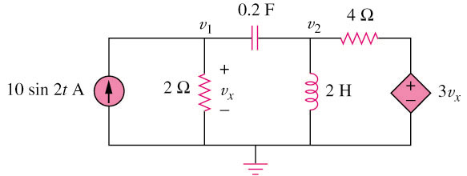
10.2 Nodal Analysis (1)
Example 1
Using nodal analysis, find v₁ and v₂ in the circuit of figure below.
Answer:
v₁(t) = 11.32 sin(2t + 60.01) V
v₂(t) = 33.02 sin(2t + 57.12) V

Slide 5
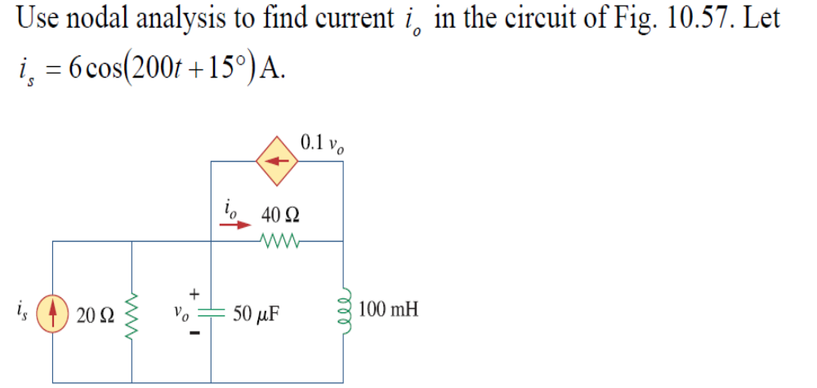
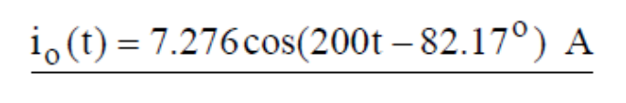
10.2 Nodal Analysis (2)
Answer:

Slide 6
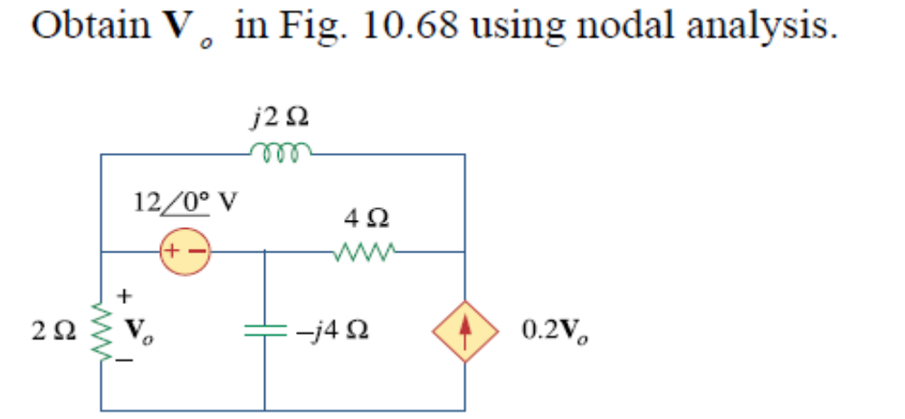

10.2 Nodal Analysis (3)
Answer:

Slide 7
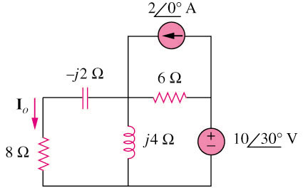
10.3 Mesh Analysis (1)
Example 2
Find I_{o} in the following figure using mesh analysis.
Answer: I_{o} = 1.19465.44 A
HW10 Ch10: 1, 7, 25, 28

Slide 8
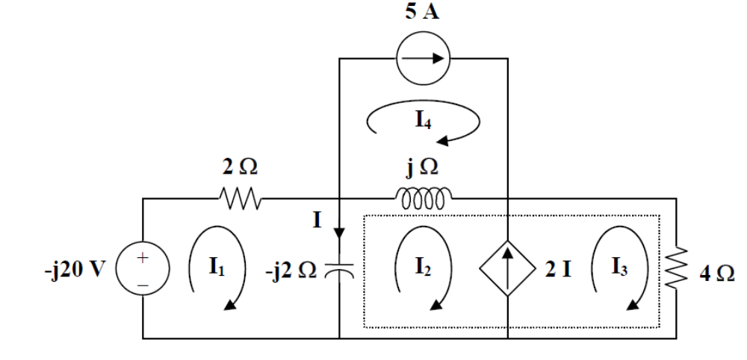
10.3 Mesh Analysis (2)

Slide 9
10.4 Superposition Theorem (1)
When a circuit has sources operating at different frequencies,
  The separate phasor circuit for each frequency must be solved independently, and
  The total response is the sum of time-domain responses of all the individual phasor circuits.

Slide 10
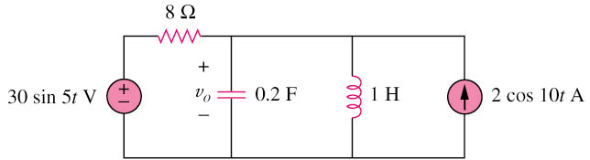
10.4 Superposition Theorem (2)
Example 3
Calculate v_{o} in the circuit of figure shown below using the superposition theorem.
V_{o} = 4.631 sin(5t – 81.12) + 1.051 cos(10t – 86.24) V

Slide 11
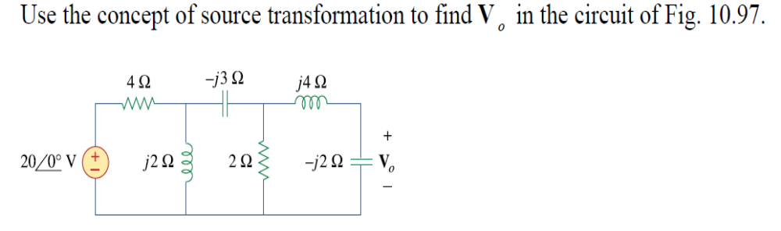
Source Transformation Theorem

Slide 12
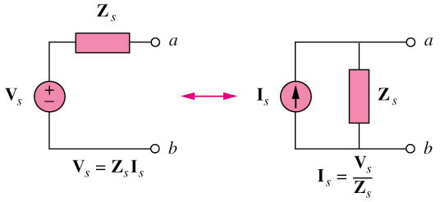
10.5 Source Transformation (1)

Slide 13
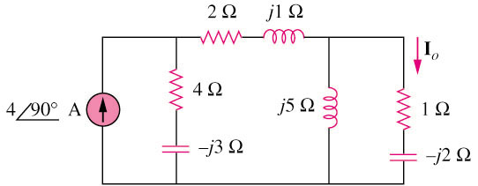
10.5 Source Transformation (2)
Example 4
Find Io in the circuit of figure below using the concept of source transformation.
I_{o} = 3.28899.46 A

Slide 14
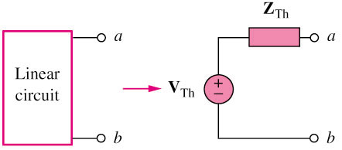
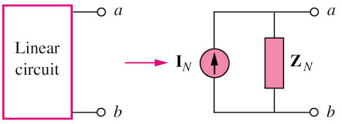
10.6 Thevenin and Norton Equivalent Circuits (1)
Thevenin transform
Norton transform

Slide 15
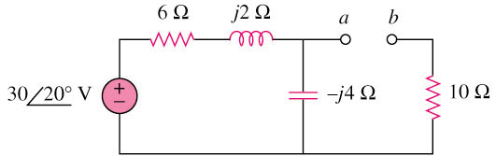
10.6 Thevenin and Norton Equivalent Circuits (2)
Example 5
Find the Thevenin equivalent at terminals a–b of the circuit below.
Z_{th} =12.4 – j3.2 
V_{TH} = 18.97-51.57 V
HW16 Ch10: 40, 45, 49, 55, 72, 79

Slide 16
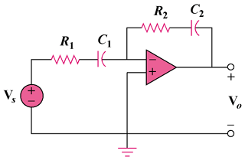
10.7 Op Amp AC Circuit
Example 5
Evaluate the voltage gain A_{v} = V_{o}/\V_{s} in the op amp circuit. Find A_{v} at ω = 0, ω → ∞, ω = 1/R₁C₁, and ω = 1/R₂C₂.

Slide 17
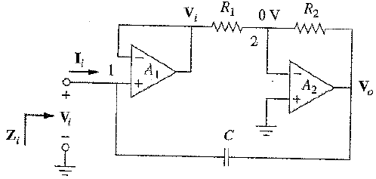
10.9 Application
Capacitance Multiplier
Find the equivalent impedance Z_{i}

Slide 18
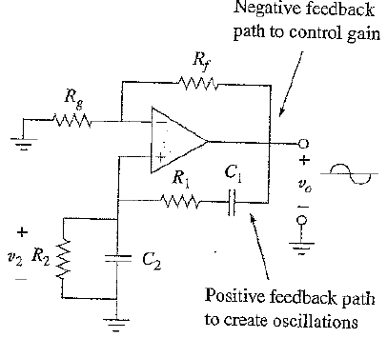
10.9 Application
Oscillator
An oscillator is a circuit that produces an ac waveform as output when powered by a dc input.
Barkhausen Criteria
1- The overall gain of the oscillator must be unity or greater. Therefore, losses must be compensated for by an amplifying device.
2- the overall phase shift (from input to output and back to the input) must be zero.
V_{o} and V₂ should be in phase
Wien-bridge oscillator

